Slide 1
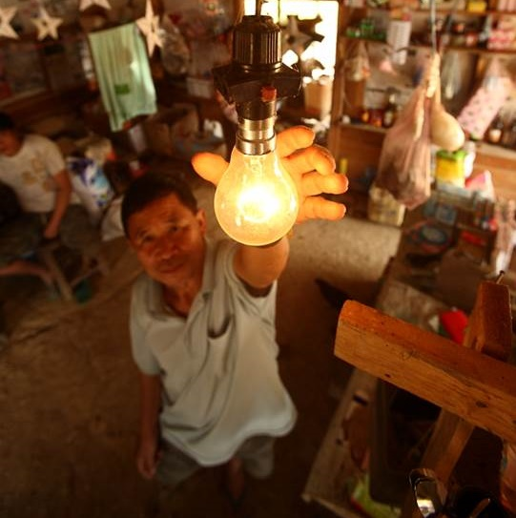
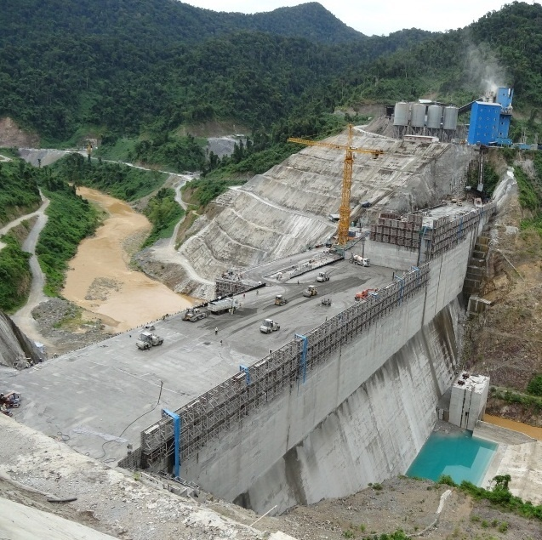
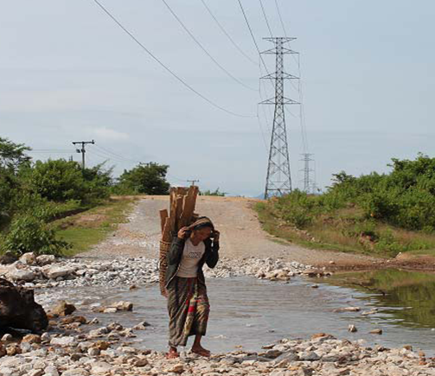

DEEM – Curriculum development and didactical skills workshop (intro)
Wageningen DEEM team
Mattijs Smits, mattijs.smits@wur.nl
Omid Noroozi, omid.noroozi@wur.nl
Hansje Eppink, hansje.eppink@wur.n

Slide 2
Contents morning programme
Introducing ourselves
The DEEM project
Learning outcomes and programme of this workshop
Getting to know each other and expectations
Energy as a wicked problem
Implications for higher education (big picture)

Slide 3
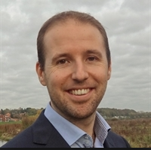

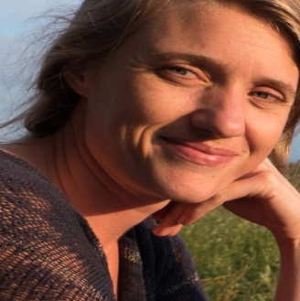
Introduction: Who is who?
Environmental policy (ENP)
Mattijs Smits
Education and Competence Studies (ECS)
Omid Noroozi
Hansje Eppink

Slide 4
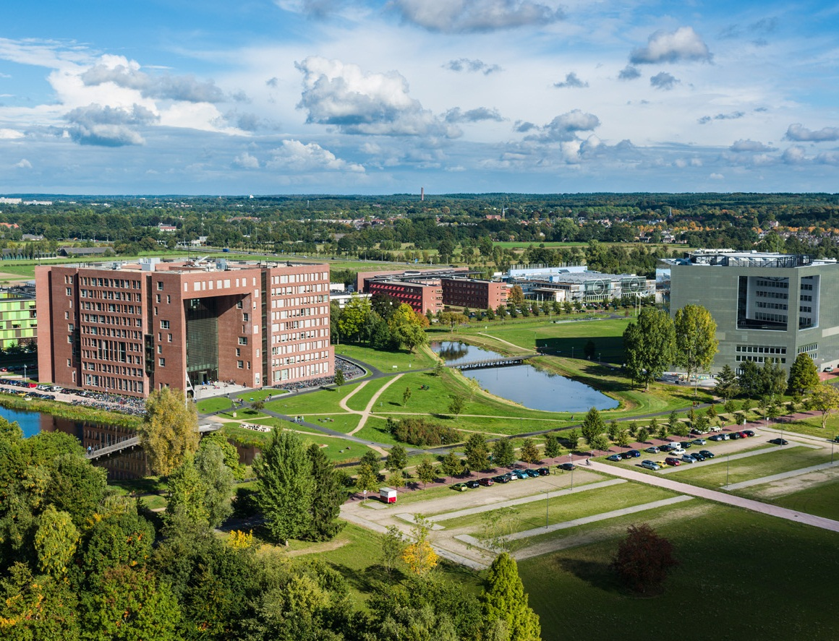
Wageningen University

Slide 5


DEVELOPMENT OF ENERGY EDUCATION IN the MEKONG AREA
2016 - 2019

Slide 6
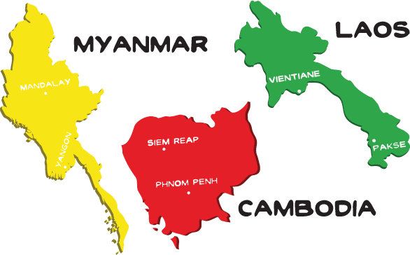
DEEM project wider objective
To ensure that Higher Education Institutions (NUOL, ITC, RUPP, YU, YTU) are able to respond to capacity and employment needs of the sustainable energy development in Cambodia, Laos and Myanmar

Slide 7
Learning goals and programme of the workshop

Slide 8
This workshop
Goal: to empower professional staff working in the field of education by creating a learning platform aiming at innovative teaching practices
3-year programme, starting today
Focus on
  Didactical skills
  Curriculum development
Not exclusively related to sustainable energy

Slide 9
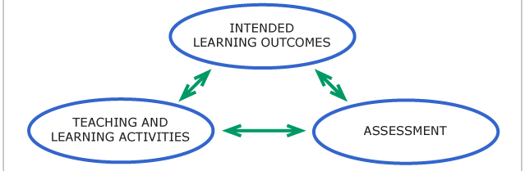
Framework of the workshop

Slide 10
Learning outcomes
To understand basic theory on curriculum development practices;
To formulate sound learning outcomes for your course or curriculum based on the taxonomy of Bloom
To explain a number of interactive and innovative teaching methods that allow for learning across various learning domains (knowledge, skills, attitude and interdisciplinary learning);

Slide 11
Learning outcomes (2)
To design a coherent assessment strategy
To reflect on own teaching competences and to develop an action plan accordingly.
To integrate the aforementioned aspects into (interdisciplinary) programmes and curricula related to sustainable energy development (and other interdisciplinary fields)

Slide 12
Programme
Day 1: expectations, curriculum approaches, and learning outcomes
Day 2: interactive and innovative teaching methods and assessment
Day 3: learning styles and development of individual action plans

Slide 13
Programme day 1
Group exercise: Getting to know each other
Group exercise:
  Teacher-centred versus student-centred learning
  Control over curriculum and courses
Lunch break
Presentation: example of alignment (course)
Presentation: Learning outcomes
Small group exercise: learning outcomes
Learning journal

Slide 14
Energy as wicked problem

Slide 15
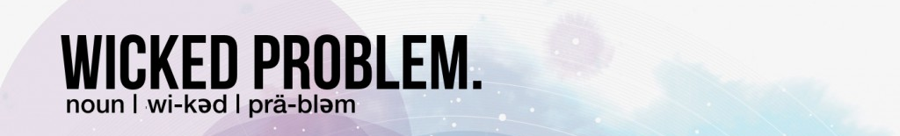
Energy as a wicked problem
= ‘A problem that is difficult or impossible to solve because of incomplete, contradictory, and changing requirements that are often difficult to recognize’

Slide 16
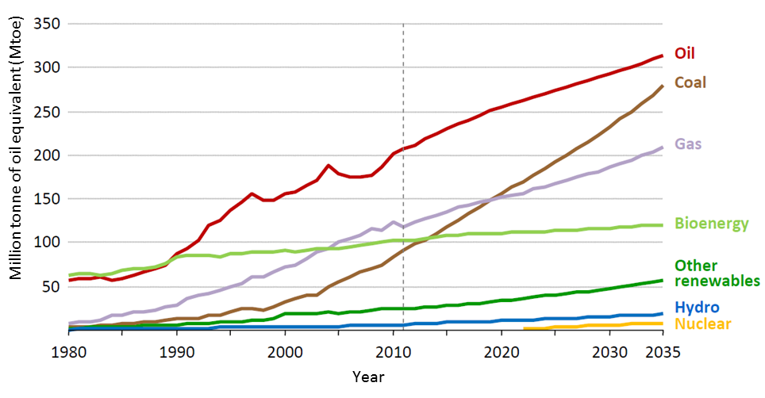
Rapid energy demand growth in Southeast Asia
Fossil fuels
Renewables
Source: IEA (2013)

Slide 17
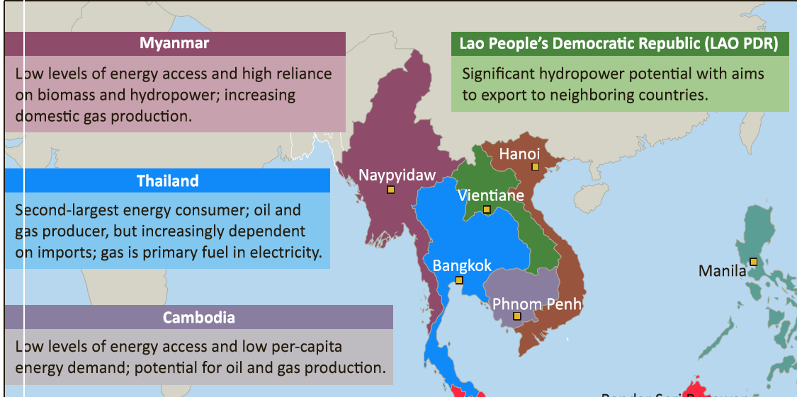
(Geo-)political issue

Slide 18
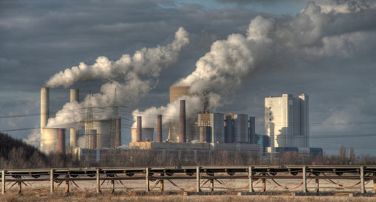
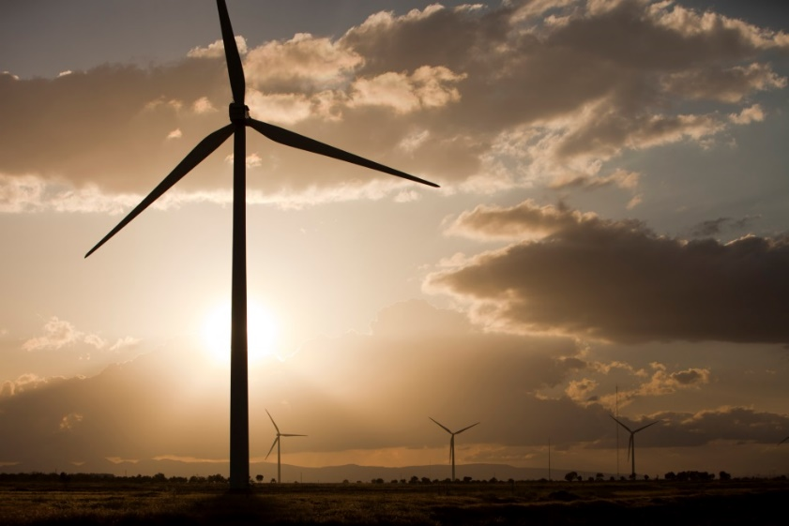
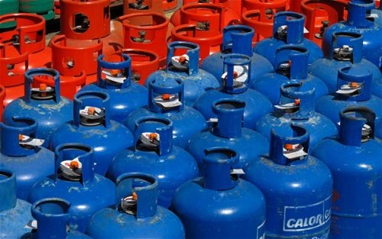
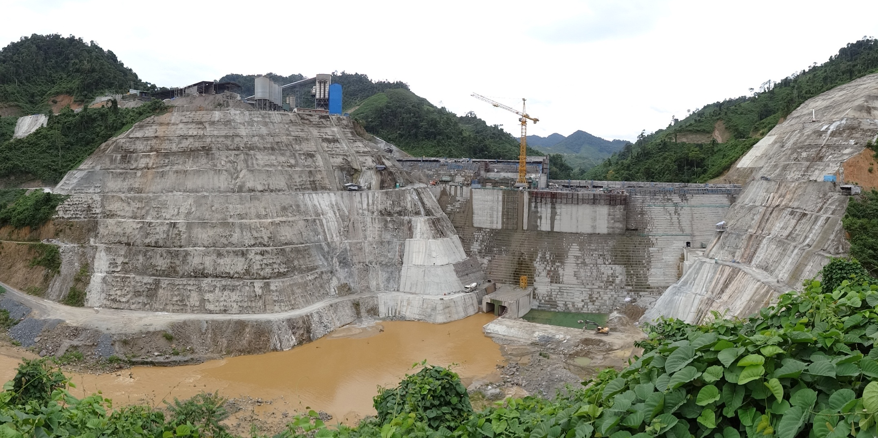
Fossil fuel vs. renewable energy

Slide 19
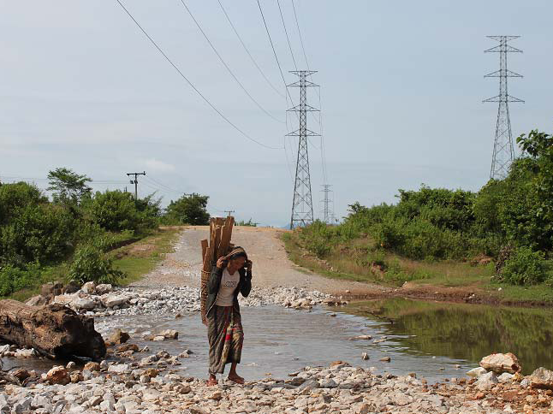
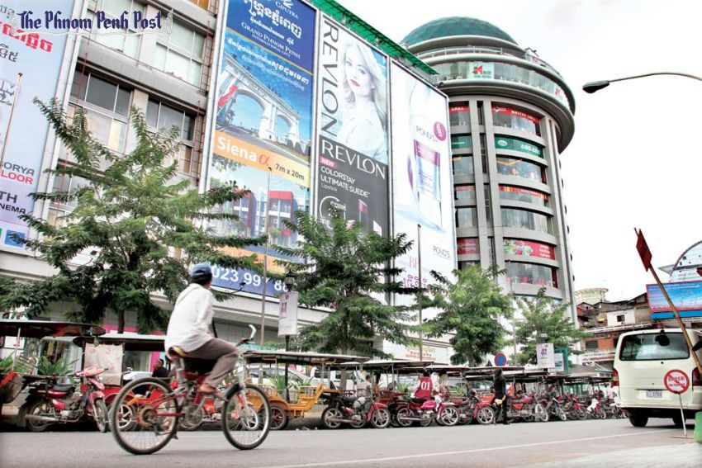
Energy poverty and development

Slide 20
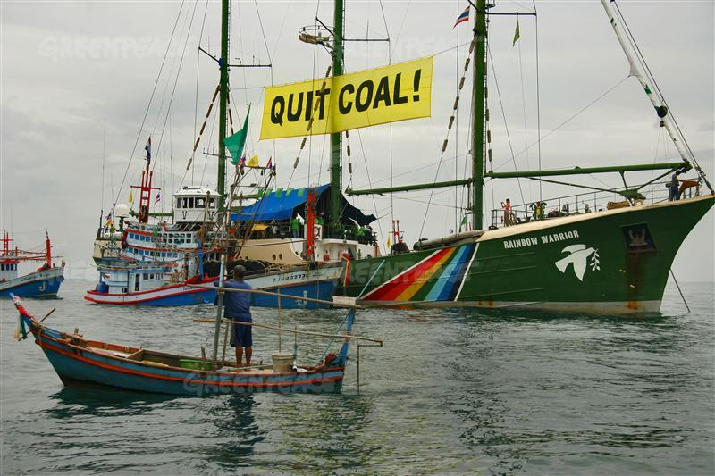
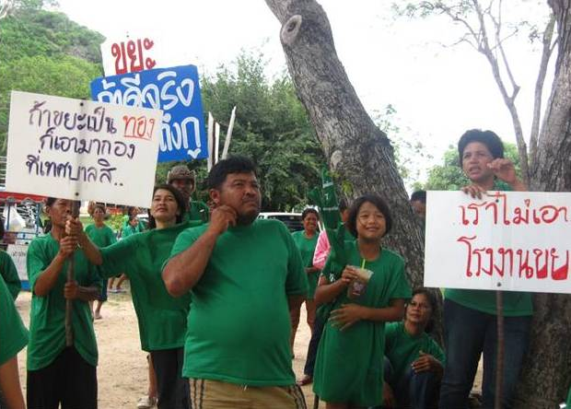
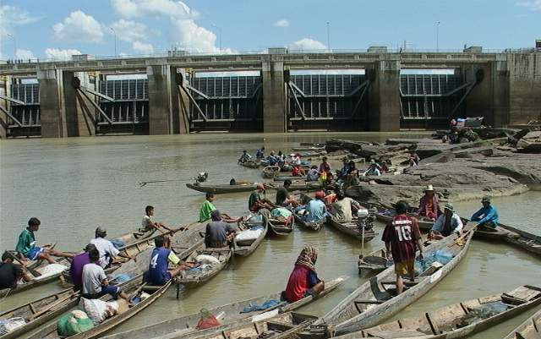
Contested models of energy development

Slide 21
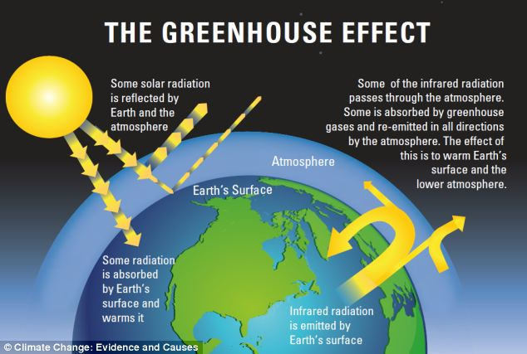
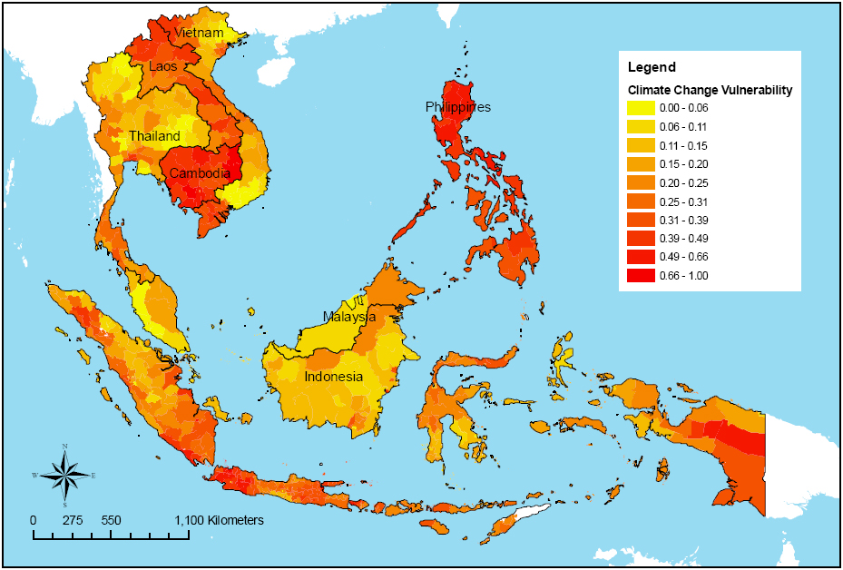
Climate change

Slide 22
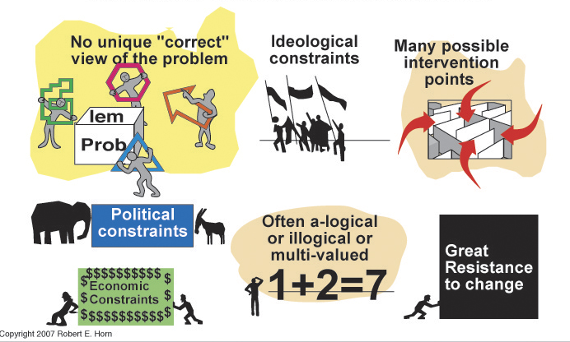
Features of wicked problems

Slide 23
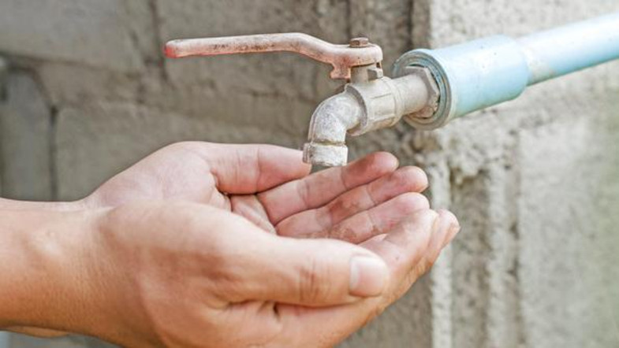
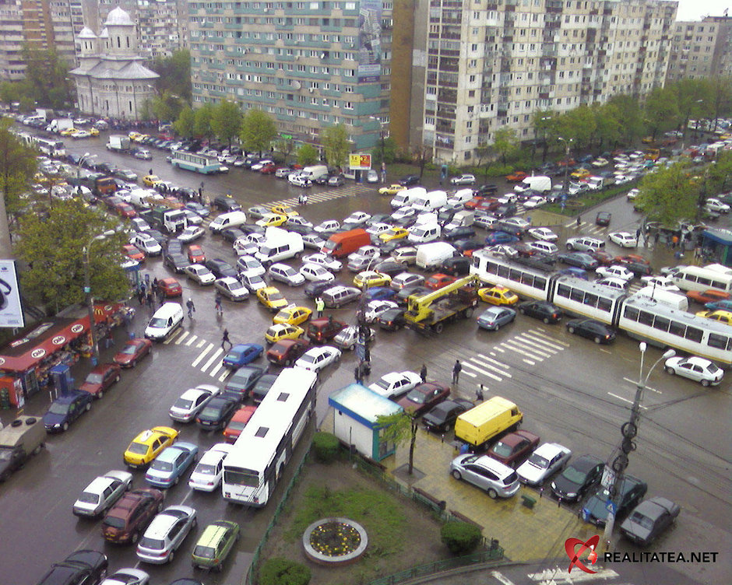

Other examples

Slide 24
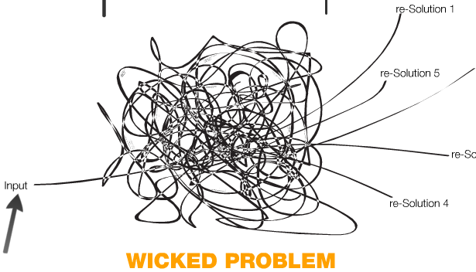
How to deal with wicked problems?

Slide 25
Implications of wicked problems for higher education

Slide 26
What can higher education do?
Provide a safe environment for learning
Make connections between people, issues, disciplines, universities and countries
Encourage innovative and critical thinking
Train new generations to deal with (new) wicked problems

Slide 27
How?
Supporting various learning styles
Facilitating interdisciplinary education
Using new tools for learning and assessment
Didactical staff training

Slide 28
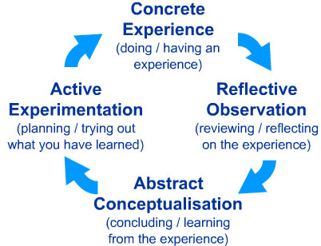
Supporting various learning styles

Slide 29
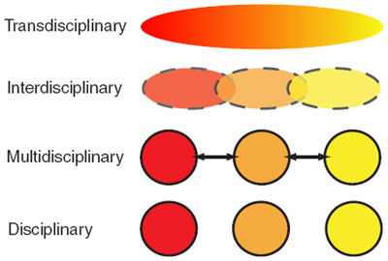
Facilitating interdisciplinary education

Slide 30


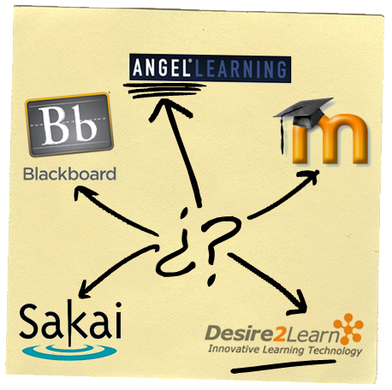
Using new tools for learning

Slide 31
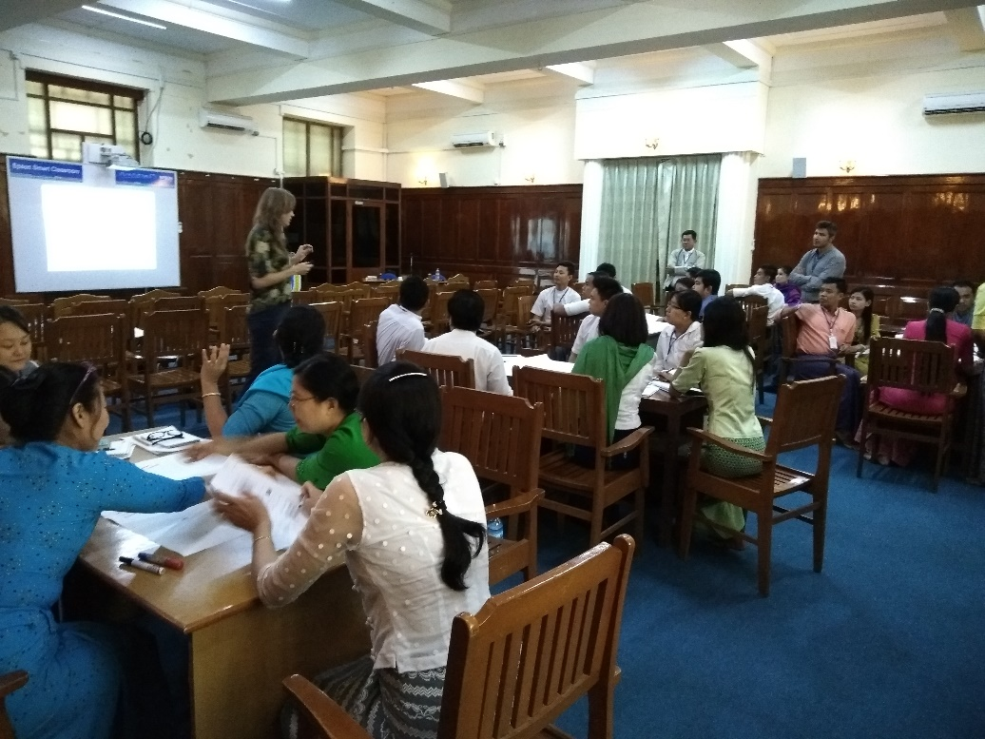
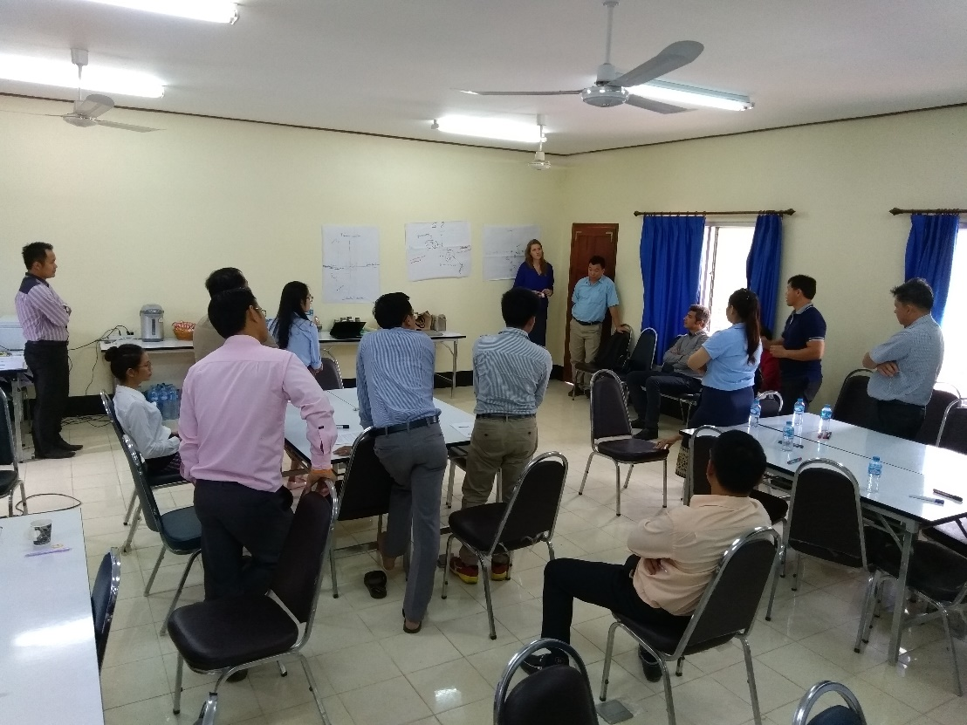
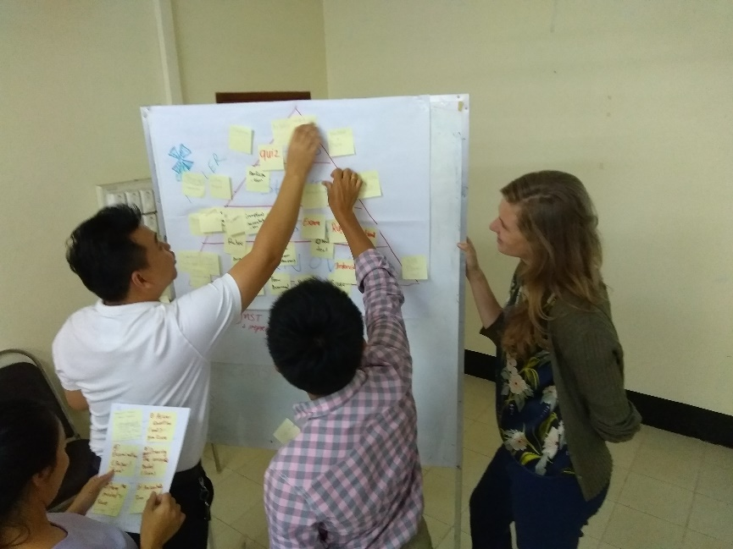
Didactical staff training

